Slide 1

Personal Voice Assistant
External Project Viva 2022-2023
Parul Institute of Computer Applications
Semester 4 Project-II
2022 - 23
Hitesh Vaishnav(210510106033) Roshan Gupta(210510104024)
Omkar Dharkar(210510110009)

Slide 2
INDEX
Abstract
Tools and Technology Used
Features of Proposed System
Limitation of Proposed System
Users and their role description
System Flow Diagram
Data Flow Diagram ( All Levels)
Use Case Diagram
Data Dictionary
Screenshots of Development Phase 1 ( Designing of your Project)
Screenshots of Development Phase 2 ( Features Implementation)
Screenshots of Development Phase 3 ( Features Implementation)
Future Enhancement
Conclusion
References

Slide 3
Abstract
Personal Assistant or conversational interface a new way of for individuals to interact with computes. The Personal Voice Assistant is a digital assistant that uses voice recognition (NLP) to provide service through a particular application. It allows a user to simply ask question in the same manner they would address a human, and are even capable of doing some basic task like opening app, reading out news, taking notes etc., with just a voice command.
This is working on speech recognition technology which change the voice command into text command (SPEECH- TO-TEXT and TEXT TO SPEECH)

Slide 4
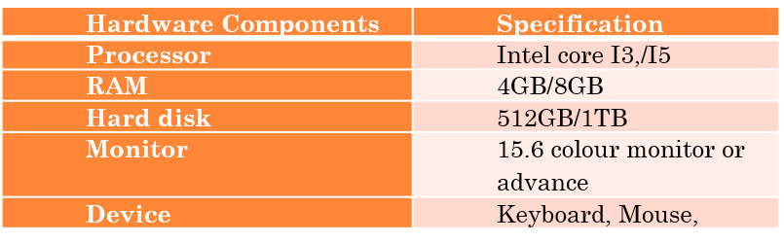
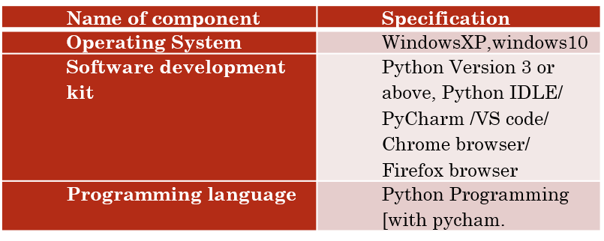
Tools and Technology Used

Slide 5
Features of Proposed System
Hot word Detection
Google search
You tube search
Web browser Access
Weather casting
Play Any music
News
Read News
Take Screenshot
Temperature
Jokes
Keyboard automation

Slide 6
Limitation of Proposed System
Voice assistants support only one-way “conversations”
In many cases, only a subset of the appliance functionality is accessible via voice assistant. This can be due to safety reasons.
They typically do not remember history — how did we do this the last time?
They depend on an Internet connection
Some time system could not connect with the user voice at that time it not give expected result.
In this voice assistant it is not stop listening.it is personal voice assistant in some case it will not work in other system.

Slide 7
Users and their role description
User:- There is user who can use it with command system will respond according to query in voice command. User can give single or more it will work on their voice command.

Slide 8
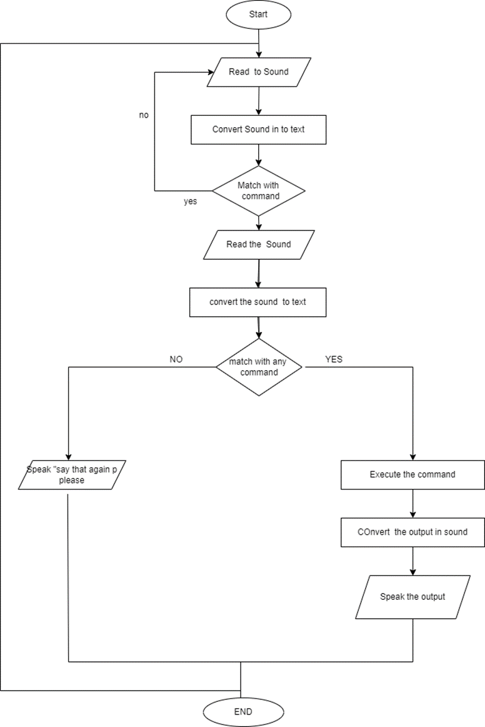
System Flow Diagram

Slide 9
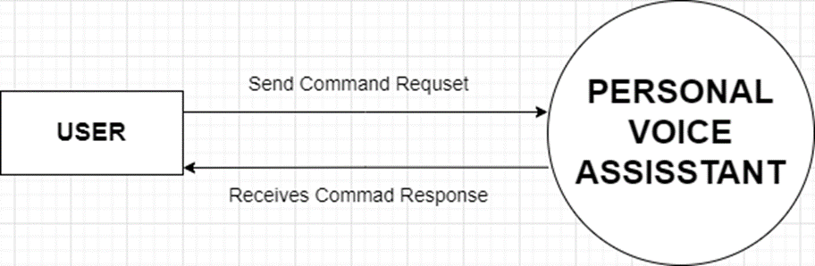
Data Flow Diagram ( All levels of DFDs)

Slide 10
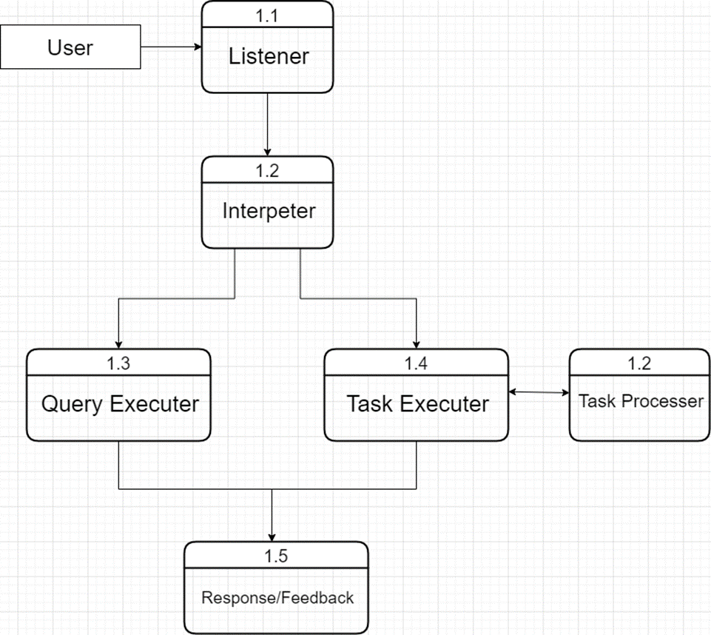
DFD Daigram level 1

Slide 11
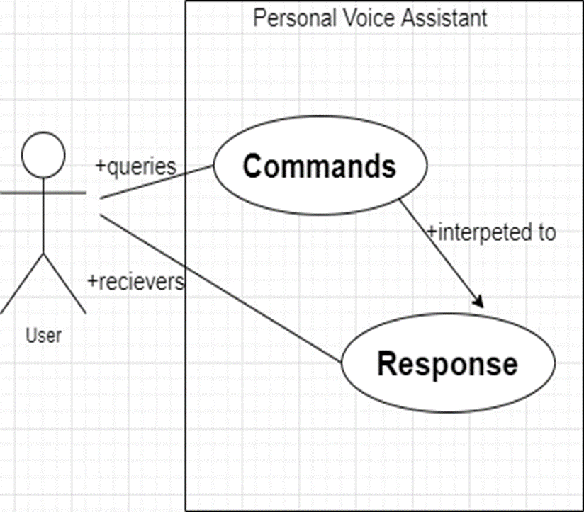
Use Case Diagram

Slide 12
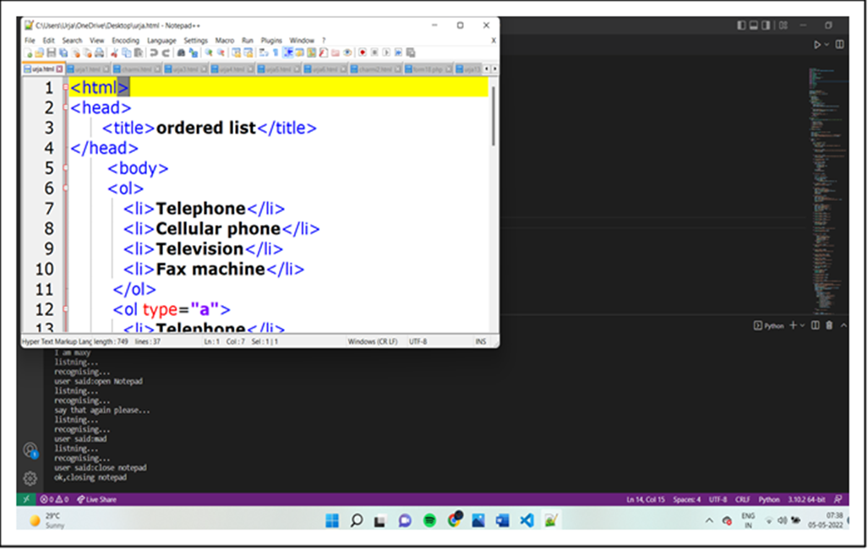
Screenshots of Development Phase 1 ( Design)

Slide 13
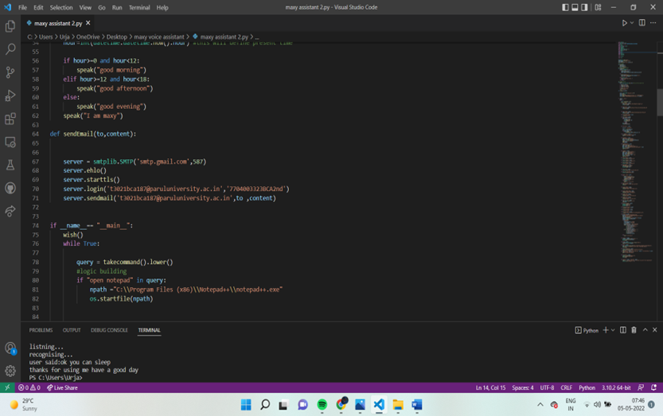
Screenshots of Development Phase 1 ( coding)

Slide 14
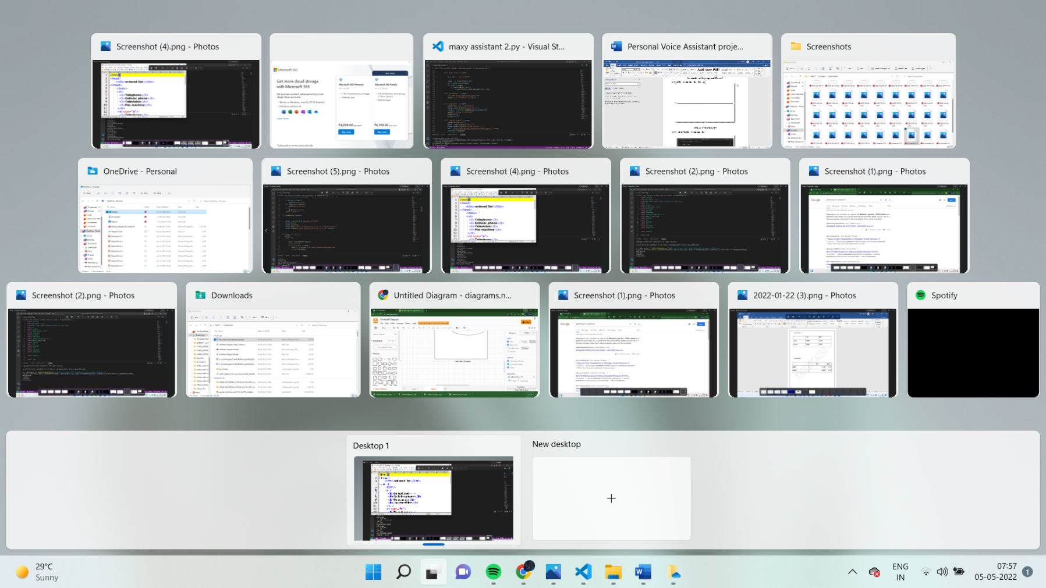
Screenshots of Development Phase 2 ( Feature)

Slide 15
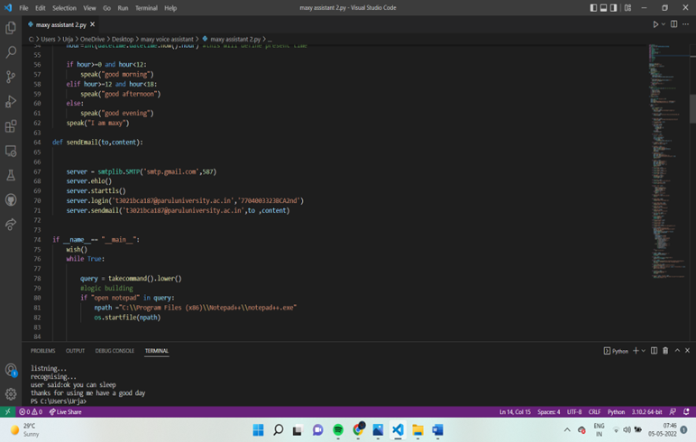
enshots of Development Phase 2 ( coding)

Slide 16
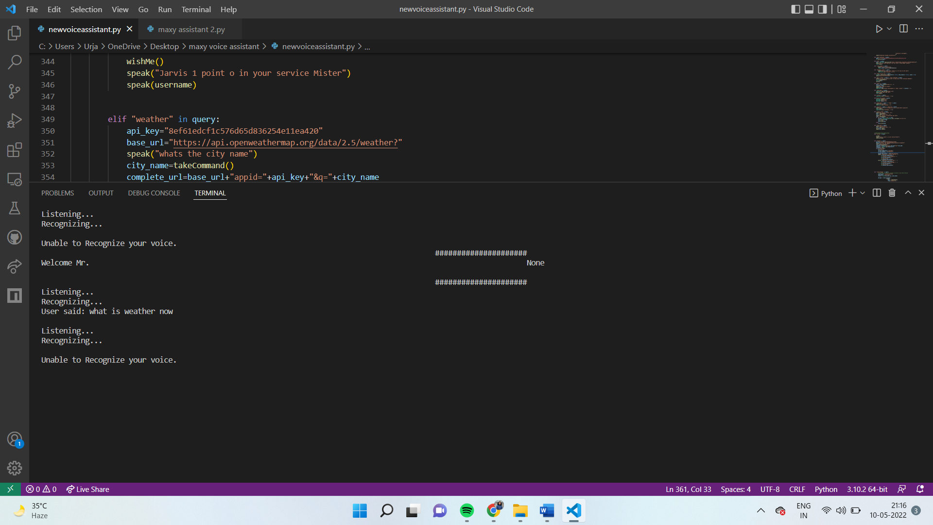
Screenshots of Development Phase 3 ( Features Implementation)

Slide 17
Future Enhancement
Change In Behaviors Of Searching.
Voice In Gaming Industry
Individualized Experiences
Voice-Tech in Healthcare
Voice Cloning
Way of Sharing Technology

Slide 18
Conclusion
This project will give us more thrilling, interesting and gives us more pleasure. It will help us in many sectors like-planning, designing, developing, managing, programming skills, socket programming and so on. For, the software part, we test our Voice assistant by applying Python Programming, and simulate the voice assistant on VS code. We use more module to built it like speech recognition,
PyWhatkit e.t.c. Through this voice assistant, we have automated various services using a single line command. It eases most of the tasks of the user like searching the web, retrieving weather forecast details, vocabulary help and medical related queries.
We aim to make this project a complete server assistant and make it smart enough to act as a replacement for a general server administration. The future plans include integrating voice assistant with mobile using React Native to provide a synchronised experience between the two connected devices. Further, in the long run, it is planned to feature auto deployment supporting elastic beanstalk, backup files, and all operations which a general Server Administrator does.

Slide 19
References
Website:
www.github.com
www.wikipedia.com
www.greeekforgriks .com
codeinformer.com
www.stackoverflow.com
www.realpython.com
Youtube and some websites
Book:
Introduction to Voice computing in python by JIM SCHWOEBEL
Other Resources:
https://www.cnet.com/products/ivee-sleek/reviews/
https://www.cnet.com/products/athom-homey/preview/

Slide 20
Thank you !!!

